Slide 1




ASCEND
Arizona State University
Presenter: Edwin Hajric
Mentor: Tom Sharp

Slide 2

Background
From the UV to IR region
Scattered by particles
      Blue light scattered most
      Reason the sky is blue
Incidence
Reflected
Infrared reflected most by Earth’s surface
Reflected
Scattered
Absorbed
Absorbed
Ozone absorbs most of harmful ultraviolet
Carbon Dioxide
Water Vapor
Transmitted
Notes:
Discuss how light gets scattered in the atmosphere, then reflected, absorbed, or transmitted through.

Slide 3
Mission Objectives
Measure and observe the behavior of light spectra coming to and from Earth throughout the atmosphere.
Earth’s surface reflects ~4-6% of light and absorbs ~50%
(other ~45% interacts with atmosphere and clouds through absorbance and reflectance)
Program a camera to track the Sun to determine its feasibility to perform as a stabilization or pointing system.
Notes:
Brief overview of objectives

Slide 4
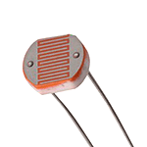
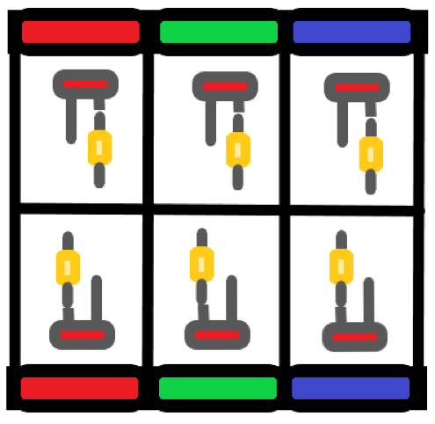
Visible Light
Light Dependent Resistors(LDR or photoresistors)
Three facing up and three facing down to measure light from above and light being reflected from below
Red-Green-Blue filter pattern to collect data from each of the three color wavelengths
220 Ohm Resistor used for each
Notes:
Filter and sensor layout

Slide 5
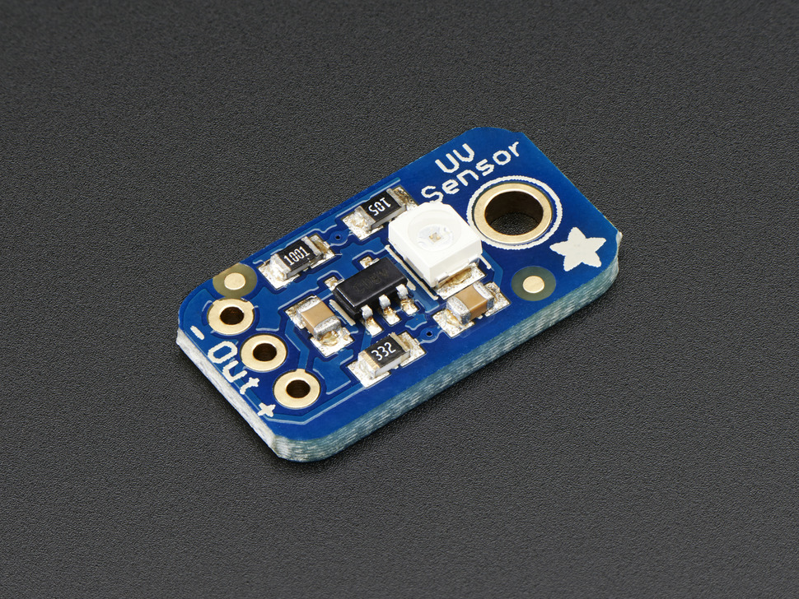
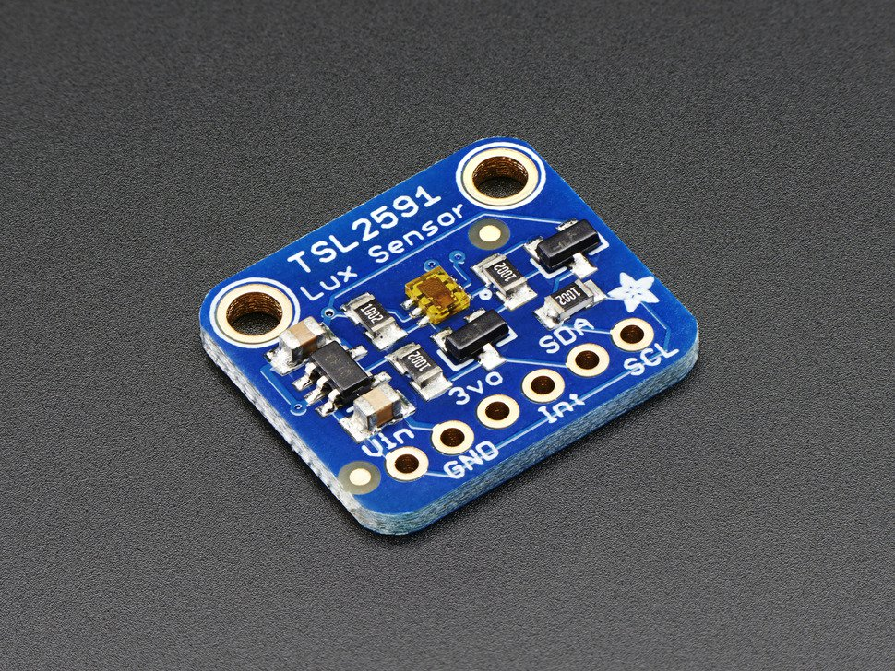
UV and IR Light
GUVA-S12SD Analog UV Sensor to measure UV light (240-370nm, UVB and UVA)
TSL2591 and TSL2561 for IR(500-1100nm) + Visible Light
TSL2591 rated for 88,000 Lux, TSL2561 for 40,000 Lux
Use all light data to observe Earth’s light absorption and reflectance
Notes:
UV and IR Light measuring sensors

Slide 6
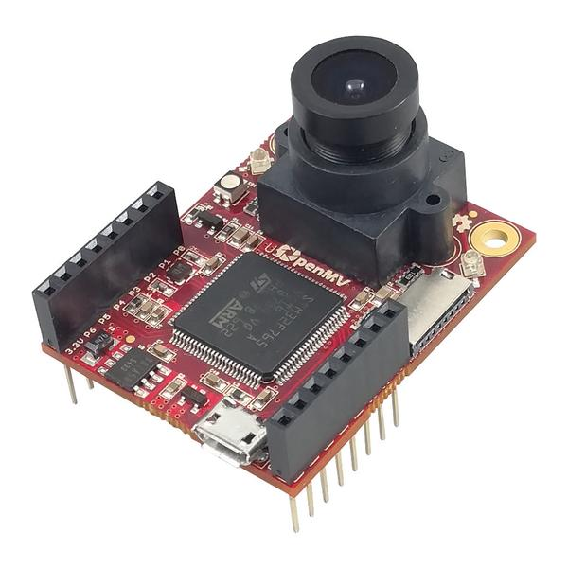
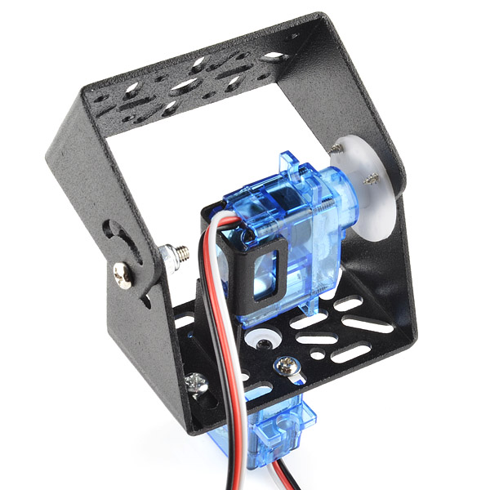
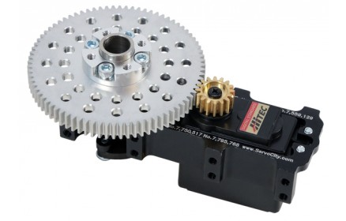
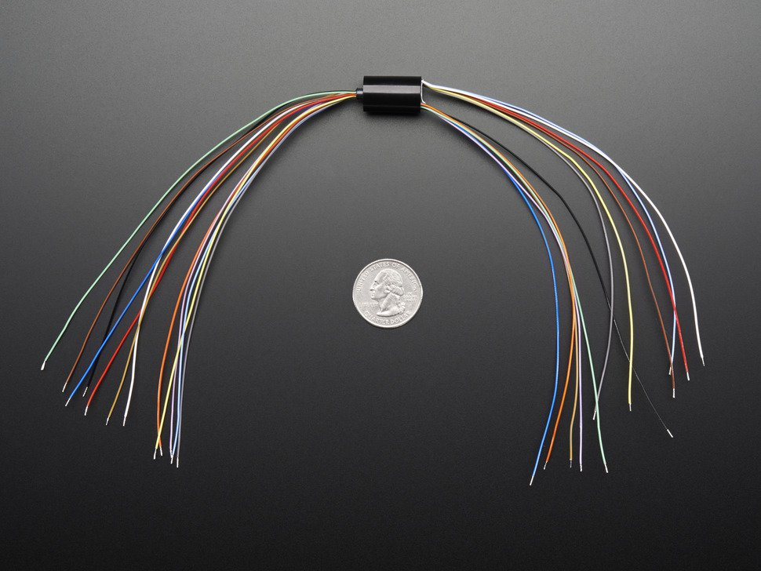
Camera System
Image processing and servos controlled by OpenMV M7 Camera
180 degree servo for tilt(vertical) axis
Continuous rotation servo for pan(horizontal) axis
Brackets mounted on gearbox
IMU mounted on camera
Use of 12-wire slipring to avoid wire entanglement
Camera and Servos each powered by separate 3 AA ultimate lithium battery packs
Notes:
Explain mechanical system

Slide 7
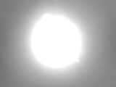
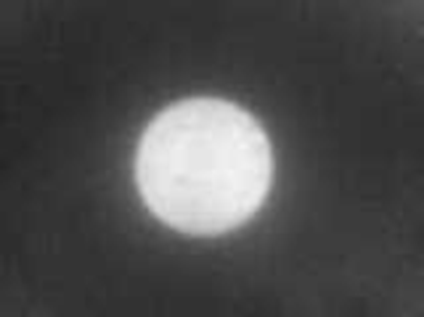
Solar Tracking Optics
Image with telephoto lens and grayscale
Image with telephoto lens, grayscale, and eclipse glasses
Notes:
Example of how the sun appears

Slide 8
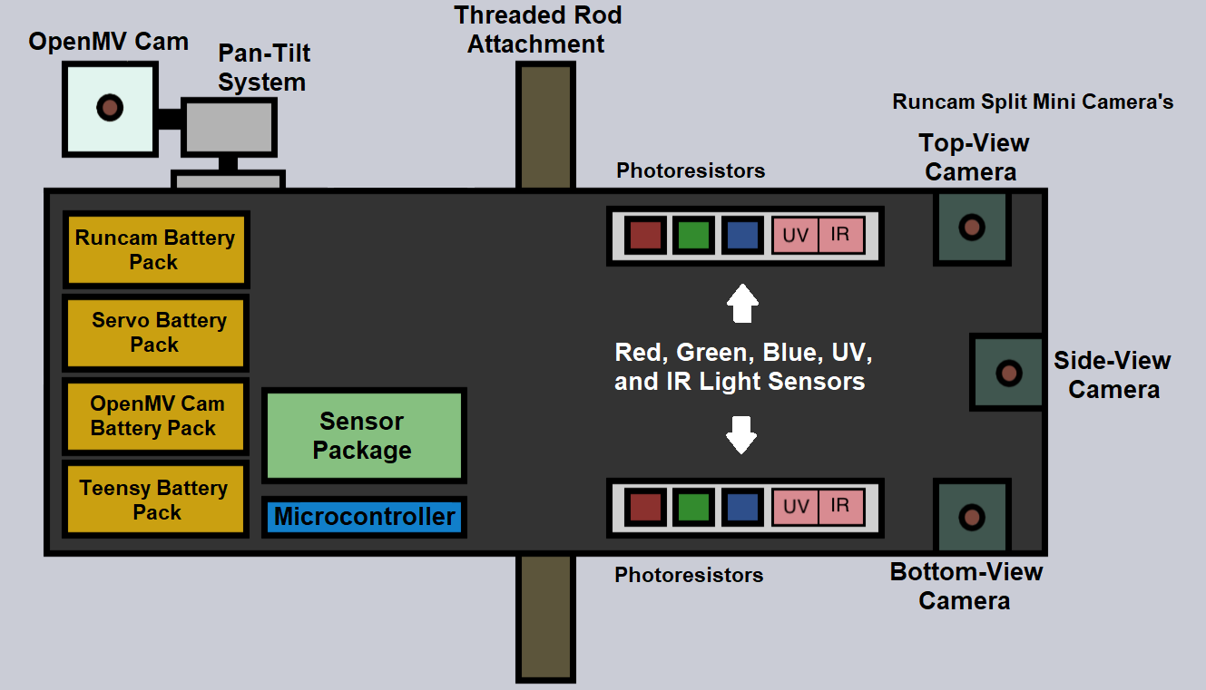
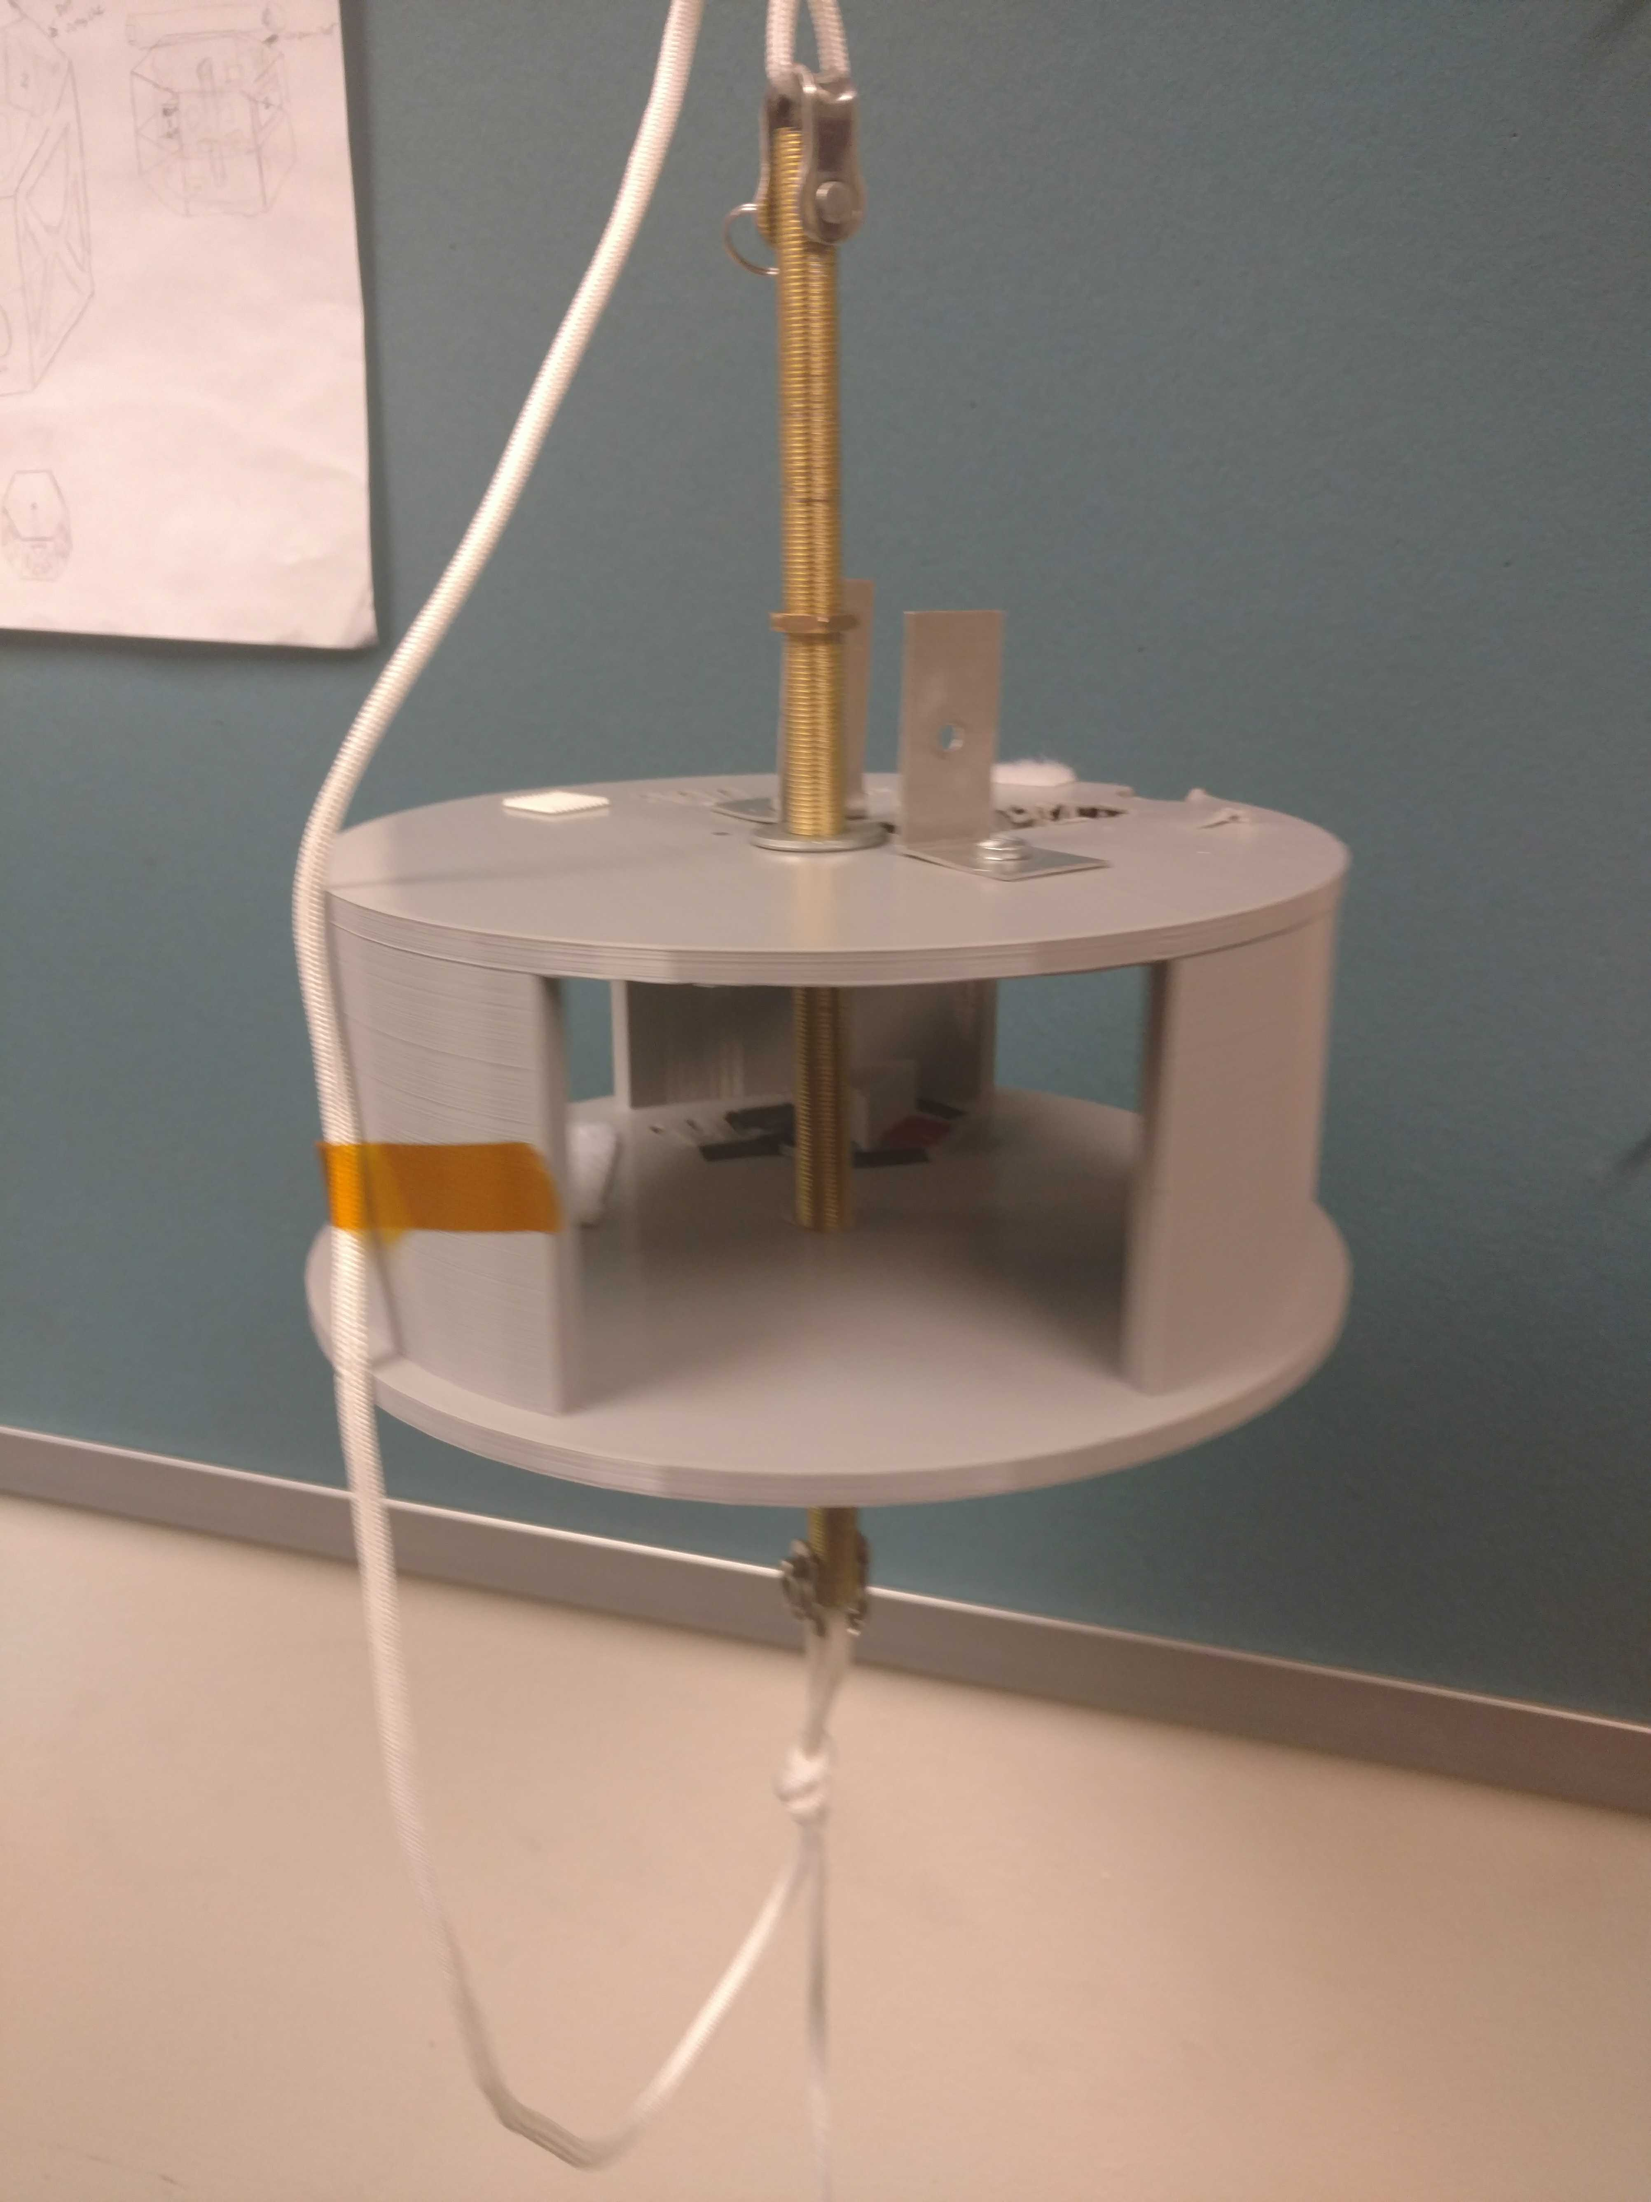
Payload
Contents:
Teensy 3.6 microcontroller
Barometer (BMP280)
9DoF IMU (LSM9DS1)
x6 Photoresistors
TSL2561
TSL2591
x3 Runcam Split Mini 2s
Open MV M7 Cam
180 Degree Hobby servo
Continuous rotation servo w/ gearbox (2:1 ratio)
x3 3 AA Battery Packs
x2 9V Batteries
(all batteries ultimate lithium)
Walls encased in styrofoam in final product
Notes:
Briefly cover payload design/contents.

Slide 9
Results
Camera Tracking System
Slip-ring wires are fragile and snap easily
Although initially soldered and electrically taped. Signal wire for horizontal continuous rotation servo got split in half during assembly.
Wire for IMU mounted on camera tracking system got split in half as well
Light Spectrum System
Power switch to sensor system’s battery pack drained overnight
(Possibly unintentionally turned on during final assembly by another component)
Runcam Split Mini Cameras
Cameras turned off shortly after being turned on for unknown reasons
Notes:
Go through results system by system

Slide 10
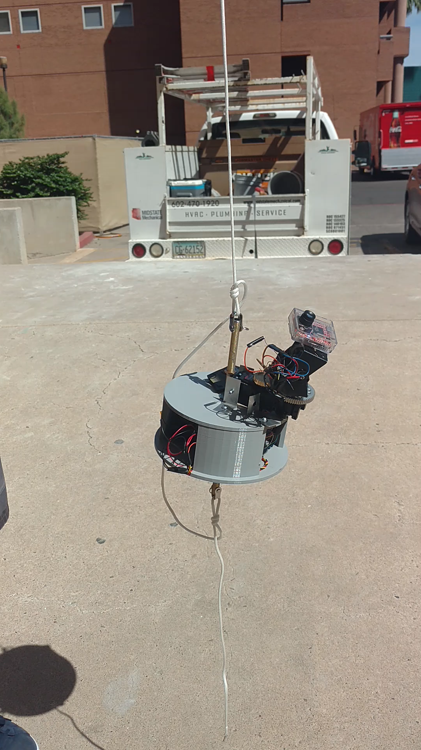
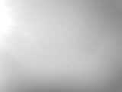
Solar Tracking Optics
Notes:
Show demo of camera tracking system post-flight (if obtained)

Slide 11
Challenges & Future
Small team and varying learning curves
Network and collaborate with engineering school and clubs
Improve structural design and assembly planning (small size of payload made assembly challenging)
Notes:
Discuss challenges faced and future improvements.

Slide 12
Thank you!
Questions?
Special Thanks to:
Thomas Sharp, Desiree Crawl, Laura Zimmerman, Susan Brew, Michelle Coe, Arizona Space Grant, ANSR

